Slide 1

Department of Computer Science and Engineering Academic Year (2023-24) 21CSE56 – Mini Project using Java SMART MACRO TRACKER
Submitted By
NAME: Chris Jordan J
USN: 1NH21CS062
SECTION: A
Guided By
Dr/Ms Devi Naveen
Senior Assistant professor
Dept. of CSE, NHCE

Slide 2
Contents
Abstract/ Objectives
Requirement Specification
Design
Methodology/ Implementation Roadmap

Slide 3
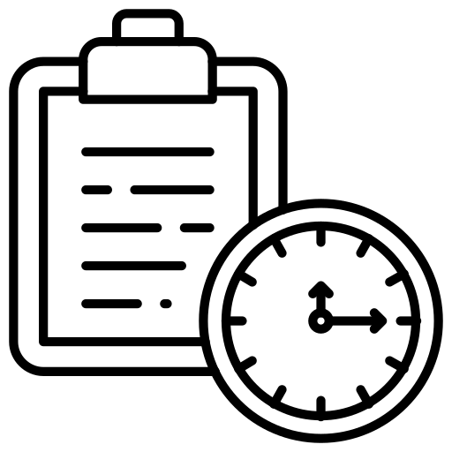






Abstract
OBJECTIVES: Develop a user-friendly system for tracking caloric and protein intake. With Integrated features like, BMI calculation, Diet plans, and water intake.
FEATURES
Track and Analyze
BMI Calculator
Diet Plans
Water Tracker
BENEFITS
HOLISTIC HEALTH MANAGEMENT
TAILORED NUTRITION
MOTIVATIONAL DRIVING FACTOR TOWARDS SUCCESS

Slide 4
Requirement Specification
Hardware Requirements:
Processor (CPU): A modern multi-core processor (e.g., Intel Core i5 or equivalent).
Memory (RAM): At least 4 GB of RAM for optimal performance.
Storage: Minimum 20 GB of available disk space for application and data storage.
Software Requirements:
Operating System (OS): Compatible with Windows 10, macOS, and popular Linux distributions (e.g., Ubuntu).
Java Runtime Environment (JRE): Required for running Java-based applications like Smart Macro Tracker.
Database Management System (DBMS): MySQL or another relational database system for storing user data.
Web Browser: Compatibility with modern web browsers (Chrome, Firefox, Safari) for web-based versions.
Development Tools: Integrated Development Environment (IDE) such as IntelliJ IDEA or Eclipse for Java development.

Slide 5
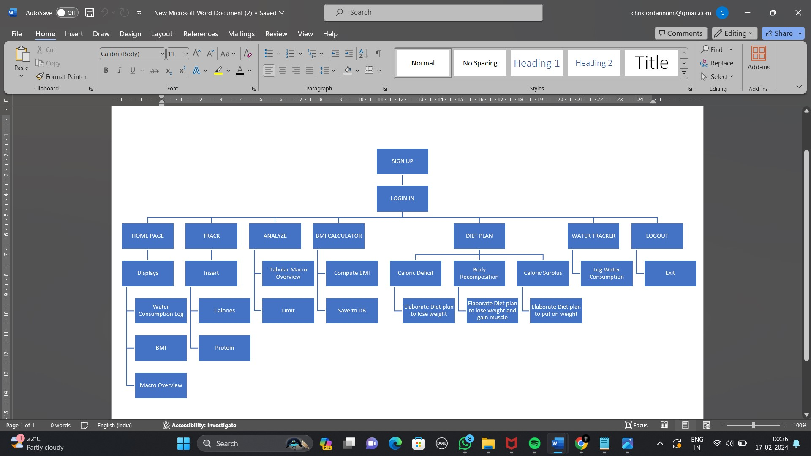
Design
BMI Calculator
Calculate BMI w Kcal
Diet Plan
Elaborate step by step instructions
Diet Plan
6. Advanced w Transformations
Advanced Settings

Slide 6








Methodology/ Implementation RoadMap
Requirement analysis
Database Schema
Java UI (Swing) Design
Testing and Debugging
Database Integration (MySQL Connector)
Backend Functionalities

Slide 7


